Slide 1
DISTRIBUTED OBJECTS AND REMOTE INVOCATION Chapter – 5 (Unit 3)

Slide 2
Objective: Communication between distributed objects by means of RMI. Objects that can receive remote method invocations are called remote objects and they implement a remote interface.
RMI: It allows an object living in one process to invoke the method of an object living in another process.
RPC: It allows client program to call procedures in server programs running in separate processes.

Slide 3
Introduction: This chapter deals with the programming models for distributed applications.That is cooperating programs running in several different processes.
Some of the programming models used are:
RPC – which allows client programs to call procedures in server programs running in separate processes.
RMI – which allows an object living in one process to invoke the methods of an object living in another process.
The event based programming model allows objects to receive notification of the events at other objects in which they have registered interest.

Slide 4
Middleware:

Slide 5
An important aspect of middleware is the provision of location transparency and independence from the details of communication protocols, operating systems and computer hardware.

Slide 6
Location Transparency:
In RPC , the client that calls a procedure cannot tell whether the procedure runs in the same process or in a different process, possibly on different computer.
In RMI , the object making the invocation cannot tell whether the object it invokes is local or not and does not need to know its location.

Slide 7
Communication Protocols:
The protocols that support the middleware abstraction are independent of the underlying transport protocols.(It uses either UDP or TCP)
Computer Hardware : Marshalling and unmarshalling messages hide the differences due to hardware architectures , such as byte ordering.
Operating System : The higher level abstractions provided by the middleware layer are independent of the underlying operating system.
Use of several programming language: CORBA allows clients written in one language to invoke methods in objects that live in server programs written in another language .

Slide 8
Interfaces:
Most programming languages organize a program as a set of modules that can communicate with one another.
Communication b/w modules can be by means of procedure calls b/w modules or by direct access to the variables in another module.
In order to control the interactions b/w modules , explicit interface is defined for each module.
The interface of the module specifies the procedures and variables that can be accessed from other modules.
Modules are implemented so as to hide all the information about them except that which is available through its interface.

Slide 9
Interfaces in Distributed System:
Input parameters are passed to the remote module by sending the values of arguments in the request msg and supplying them as arguments to the operation to be executed in the server.
Output parameters are returned in the reply msg and are used as the result of the call or to replace the values of the corresponding variable in the calling environment.
Pointers are not allowed to be passed as arguments or returned as results of calls to remote modules.

Slide 10
Interfaces used in the client server model for RPC and in the distributed model for RMI:
Service Interface :
In the client server model , each server provides a set of procedures that are available for use by clients. Eg. File server provides procedures for reading and writing files.
So the term service interface is used to refer to the specification of the procedures offered by the server.
Remote Interfaces:
Remote interface specifies the methods of an object that are available for invocation by objects in other processes, defining the type of input and output arguments of each of them.
Methods in remote interfaces can pass objects as arguments and results of methods.

Slide 11
Communication b/w Distributed Objects:
The Object Model
Distributed Objects
Distributed Object Models
Design Issues
Implementation
Distributed Garbage Collection

Slide 12
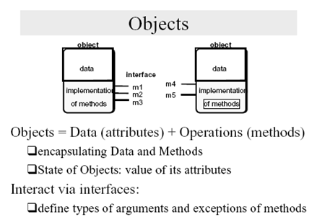
Object Model:

Slide 13
1. Objects consist of set of data and set of methods.
2. Objects encapsulate their data and the code of their methods
3. An object communicate with other objects by invoking their methods, by passing arguments and receiving results.

Slide 14
Object References:
Objects are accessed via object references.
To invoke a method in an object , the object references and method name are given together with necessary arguments.
Interfaces:
An interface provides a definition of a set of methods (type of arguments, return values and exception etc.) without specifying their implementation.
Actions:
It is an object invoking a method in another object.
The receiver executes the appropriate method and the returns control to the invoking object.

Slide 15
Exceptions:
During the execution of the method, many different problems may be discovered.
a) Inconsistent values in the object variables
b) failure in read or write to files or n/w sockets
Exceptions provide a clean way to deal with error conditions without complicating the code.
A block of code may be defined to throw exception whenever particular unexpected conditions or error arise. That is control passes to another block of code that catches the exception.

Slide 16
Garbage Colletion:
It is necessary to provide a means of freeing the space occupied by objects when they are no longer needed.
A language eg. JAVA detect automatically when an object is no longer accessible recovers the space and makes it available for allocation to other objects.

Slide 17
Distributed Objects:
Distributed objects adopt client-server architecture.
In this objects are managed by servers and their clients invoke their methods using remote method invocation.
In RMI, clients request to invoke a method of an object is sent as a msg to server managing the object.
Invocation is done by executing the method of the object at the server and the result is returned to the client in another msg.
Objects can be replicated for fault tolerance and migrated to enhance their performance and availability
State of an object can be accessed only by the method of the object, ie. it is not possible for unauthorized methods to act on the state.

Slide 18
Distributed Object Model
Remote and local method invocations
remote
local
C
local
E
invocation
invocation
invocation
remote
invocation
F
A
B
local
invocation
D

Slide 19
Each process contains a collection of objects some of which can receive both local and remote invocations.
Method invocation b/w objects in different processes – remote method invocation.
Method invocation b/w objects in the same process – local method invocations.
Objects that receive remote invocations are as remote objects ie. Object B and F are remote objects.

Slide 20
Object C must have a reference to object E so it can invoke one of its method.
Two fundamental concepts of DOM:
* Remote object reference
i.e remote object reference for B must be available to A.
* Remote Interface – Every remote object has remote interface that specifies which of the method can be invoked remotely.

Slide 21
Remote Object Reference:
Any remote object reference is an unique identifier to refer to a particular unique remote object.
The remote object to receive a RMI is specified by the invoker as remote object reference.
Remote object references may be passed as arguments and results of remote method invocations.

Slide 22
A remote object and its remote interface
remote
object
remote
Data
interface
m4
{
m1
implementation
m2
m5
m3
of methods
m6

Slide 23
Remote Interfaces:
The class of remote object implements the method of its remote interface
Objects in other processes can invoke only the methods that belong to its remote interface.
Local objects can invoke the methods in the remote interface as well as other methods implemented by the remote object.

Slide 24
Actions in a Distributed Object System:
In distributed case , objects involved in a chain of related invocations may be located in different processes .
When the invocation crosses the boundary of a process, RMI is used and remote object reference is known to the invoker.
In the fig Object A needs to hold remote object reference to object B.
Remote object reference may be obtained as a result of remote method invocation
For eg. Object A might obtain remote object reference to object F from object B.

Slide 25
The distributed object model
Actions in a distributed object system: - is initiated by a method invocation, which may result in further invocations on methods in other objects. . . - when an action leads to the instantiation of a new object, that object will normally live with in the process where instantiation is requested. if the newly instantiated object has a remote interface, . . . - distributed applications may provide remote objects with methods for instantiating objects which can be accessed by RMI.

Slide 26
Instantiation of remote objects
Suppose object L contains a method for creating remote objects, then the remote
invocations from C and K could lead to the instantiation of the objects M and N.

Slide 27
Garbage Collection:
If garbage collection is not available , then remote objects that are no longer required should be deleted.
Garbage collection is achieved by cooperation b/w the existing garbage collecter and added module that carries out a form of distributed garbage collection based on reference counting.

Slide 28
Exception:
The process containing the remote object may have crashed or may be too busy to reply, or the invocation or result message may be lost.
So RMI should be able to raise exception such as timeout etc…

Slide 29
Design Issues for RMI
Design issues in making RMI a natural extension of local method invocation:
- The choice of invocation semantics. - The level of transparency that is desirable for RMI.

Slide 30
Two design issues – RMI Invocation Semantics and → Transparency
Design Issues for RMI:
RMI invocation semantics - the doOperation can be implemented in different ways to provide different delivery guarantees.
Retry request message – whether to retransmit request msg until reply received or server assumed to have failed.
Duplicate filtering – when retransmission, whether to filter out duplicates
Retransmission of results – whether to keep a history of result msgs to enable lost results to be retransmitted without re-executing.

Slide 31
Combinations of these choices lead to a variety of possible semantics
for the reliability of remote invocations.
Different choices of Invocation semantics are defined :
Exactly once invocation semantics:
For local method invocations, the semantics are exactly once – every method executed exactly once.

Slide 32
Maybe invocation semantics:
In this, the invoker cannot tell whether a remote method has been executed once or not at all. This arises when none of the fault tolerant measures applied.
This can suffer from the failure like,
# Omission failure – invocation or result msg is lost
# Crash failure – server containing the remote object fails
If the result msg has not been received after a time out and there are no retries, it is uncertain whether the method has been executed.
If the invocation msg lost - then the method will not have been executed.
If the result msg lost , after the method got executed
crash failure occur before or after the execution of method.
So Maybe semantics is useful only for applications in which occasional failed invocations are acceptable

Slide 33
At-least-once invocation semantics:
Invoker receives either a result, ie. Invoker knows that the method was executed atleast once or exception informing that no result was received.
Atleast once semantics is achieved by retranmission of request msgs , which masks the omission failure of the invocation or result msg.

Slide 34
Atleast once suffer from following types of failure:
Crash failures –when server containing remote object fails.
Arbitrary failures – when the invocation msg is retransmitted, the remote object may receive it and execute the method more than once, causing wrong values to be stored or returned.
Non- idempotent operation can have wrong effect if they perform more than once.eg. To increase bank balance – should be performed only once.
So if the server is designed for idempotent operation, then at-least –once call semantic is acceptable.

Slide 35
At-most –once semantics:
With atmost once invocation , the invoker receives either a result in which case the invoker knows that the method was executed exactly once or an exception informing that no result was received, in which the method will have been executed either once or not at all.
In both java RMI and CORBA the invocation semantics is at-most once , but CORBA maybe semantics to be requested for methods that do not return results.

Slide 36
Invocation semantics
Fault tolerance measures
Invocation
semantics
Retransmit request
Duplicate
Re-execute procedure
message
filtering
or retransmit reply
No
Not applicable
Not applicable
Maybe
Yes
No
Re-execute procedure
At-least-once
Yes
Yes
Retransmit reply
At-most-once

Slide 37
Transparency:
All necessary calls to marshalling, unmarshalling, msg passing procedures are hidden from the user as well as invoking local and remote servers.
This extended to distributed objects in locating and contacting remote objects.
Remote invocations are vulnerable to failure than local ones… always there would be chance of no reply …and in case of failures , it is impossible to distinguish n/w and remote server process.
Latency of remote invocation is greater than local ones.
Exception handlers can be included to handle some of the failures and we can also specify the semantics so in some cases at least once can be chosen to avoid overheads of at most once by making operation idempotent.

Slide 38
Implementation of RMI:
Several separate objects and modules are involved in achieving a remote method invocation.
Application level object A invokes a method in a remote application level object B for which it holds a remote object reference.

Slide 39
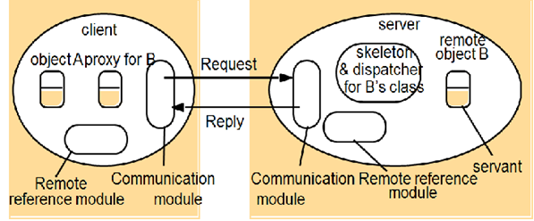
The Role of proxy and skeleton in remote method invocation:

Slide 40
messageType
int (0=Request, 1= Reply)
requestId
int
objectReference
RemoteObjectRef
methodId
int or Method
arguments
array of bytes
Communication Module:
The two cooperating communication modules carry out the request – reply protocol, which transmits request and reply msgs b/w client and server.(refer request-reply msg structure in chapter-4)
Communication module uses only the first three items ie. Msg type, request id, remote object reference of the object to be invoked.
The methodId, marshaling and unmarshalling are concerned with RMI software (proxy, dispatcher and skeleton).
The communication module in the server select the dispatcher for the class of the object to be invoked , passing its local reference which it gets from remote reference module.

Slide 41
Remote Reference Module:
A remote reference module is responsible for translating b/w local and remote objects references and for creating remote object references.
The remote reference module in each process has a remote object table that records the correspondence b/w local object references in that process and remote object references.

Slide 42
This table includes,
An entry for all remote objects held by the process.eg. Remote object B will be recorded in the table at the server.
An entry for each local proxy. The proxy for B will be recorded in the client.

Slide 43
The actions of remote reference module:
When a remote object is to be passed as argument or result for the first time , the remote reference module is asked to create a remote object reference, which it adds to its table.
When a remote object reference arrives in a request or reply msg, the reference module is asked for the corresponding local object reference, which may refer either to proxy or to a remote object.
When a request msg arrives, the table is used to find out which local object is to be invoked.

Slide 44
Servants:
A servant is an instance of class which provides the body of remote object. It is the servant that handles the remote request passed on by the skeleton.
Servants live within a server process.
After the service, it is being garbage collected or deleted.

Slide 45
RMI Software:
Proxy:
The role of proxy is to make RMI transparent to clients by behaving like a local object.
Instead of executing the invocation, it forwards it in a msg to a remote object.
It hides the details of remote object reference , marshaling of arguments, unmarshalling of results and sending and receiving of msgs from the clients.
There is one proxy for each remote object , for which the process holds a remote object reference.

Slide 46
Each method in the proxy marshals the reference to the target object, its own method Id and its arguments into a request msg and send it to the target.
It awaits the reply, unmarshalls it, and returns the result to the invoker.

Slide 47
Dispatcher:
A server has one dispatcher and skeleton for each class representing a remote object.
In the above diagram, server has a dispatcher and skeleton for the class of remote object B.
The dispatcher receives the request from the communication module.
It uses methodId to select the appropriate method in the skeleton
The dispatcher and the proxy uses the same allocation of method ids to the method of remote interface.

Slide 48
Skeleton:
It implements the method in the remote interface.
A skeleton method unmarshalls the argument in the request msg and invokes the corresponding method in the remote object.
It waits for the invocation to complete and then marshalls the result, together with any exceptions, in a reply msg to the sending proxy’s method.

Slide 49
Distributed Garbage Collection:
The aim is to ensure that if a local or remote reference to an object is still held anywhere in a set of distributed objects, then the object itself will continue to exist, but no object any longer holds a reference to it, the object will be collected and the memory it uses recovered.

Slide 50
Implementation of RMI
Java distributed garbage collection algorithm - based on reference counting. - whenever a remote object reference enters a process, a proxy will be created. - the server should be informed of the new proxy at the client. - later when there is no longer a proxy at the client, the server should be informed.

Slide 51
Implementation of RMI
Each server process maintains a set of the names of the processes that hold remote object references for each of its remote objects; Ex: B.holders is the set of client processes that have proxies for object B.
When a client C first receives a remote reference to a particular remote object, B, it makes an addRef(B) invocation to the server of that remote object and then creates a proxy; the server adds C to B.holders.

Slide 52
Implementation of RMI
When a client C's garbage collector notices that a proxy for remote object B is no longer reachable, it makes a removeRef(B) invocation to the corresponding server and then deletes the proxy; the server removes C from B.holders.
When B.holders is empty, the server's local garbage collector will reclaim the space occupied by B unless there are any local holders.

Slide 53
Remote procedure call
A client program calls a procedure in another program running in a server process.
Servers may be clients of other servers to allow chains of RPCs.
A server process defines in its service interface the procedures that are available for calling remotely.

Slide 54
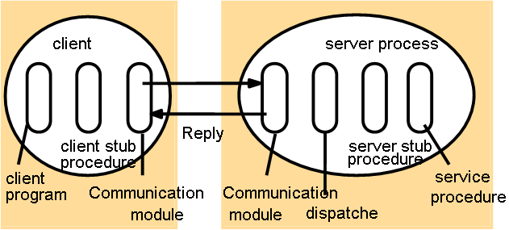
Remote Procedure Call

Slide 55
A client program calls the procedure in another program running in the server process.
Servers may be clients of another servers to allow chains of RPC’s.
Server process defines its server interface, which holds the procedures that are available for calling remotely.
This also uses any one of the semantics such as atleast once or atmost once.
Here no remote reference modules since procedure call is not related with object and object references.
Client includes one stub procedure for each procedure in the service interface.

Slide 56
The role of stub procedure is similar to that of proxy.
It behaves like a local procedure to client, but instead of executing the call ,it marshalls the procedure identifier and the arguments in the request msg, which it sends via communication module to the server. When reply msg arrives , it unmarshalls the result.
The server process contains a dispatcher together with one server stub procedure and one service procedure for each procedure in the service interface.

Slide 57
The dispatcher selects one of the server stub procedures according to the procedure identifier in the request msg.
A server stub procedure is like a skeleton method, it unmarshalls the argument in the request msg, calls the corresponding service procedure and marshalls the return value in the reply msg.
The server procedures implement the procedures in the service interface.

Slide 58
A client makes remote procedure calls to a server. The client takes 5 milliseconds to compute the arguments for each request, and the server takes 10 milliseconds to process each request. The local operating system processing time for each send or receive operation is 0.5 milliseconds, and the network time to transmit each request or reply message is 3 milliseconds. Marshalling or unmarshalling takes 0.5 milliseconds per message.
Calculate the time taken by the client to generate and return from two requests:
(i) if it is single-threaded, and
(ii) if it has two threads that can make requests concurrently on a single processor.

Slide 59
i) time per call = calc. args + marshal args + OS send time + message transmission + OS receive time + unmarshall args + execute server procedure + marshall results + OS send time + message transmission + OS receive time + unmarshal args
= 5 + 4*marshal/unmarshal + 4*OS send/receive + 2*message transmission + execute server procedure
= 5+ 4*0.5 + 4*0.5 + +2*3 + 10 ms = 5+2+2+6+10 =25ms.
Time for two calls = 50 ms.
Try out second……with two threads...

Slide 60
Events and Notification:
The idea behind is, one object can react to a change occurring in another object.
The objects that are responsible for displaying a view of the current state are notified whenever the state changes.
Distributed event-based systems extend the local event model by allowing multiple objects at different locations to be notified of events taking place at an object.
They use the publish-subscribe paradigm, in which an object that generates events publishes the type of events that it will make available for observation by other objects.

Slide 61
Objects that want to receive notification from an object that has published its events subscribe to the types of events that are interest to them.
Objects that represent events are called notification.
When publisher experiences an event , subscribers that expressed an interest in that type of event will receive notifications.
Subscribing to a particular type of event is also called registering interest in that type of event.
Informing a change in the document, person entered or left the room are some of the examples of event and notification.

Slide 62
Distributed event-based systems have two main characteristic:
Heterogeneous:
When event notifications are used as a means of communication b/w distributed objects, components in a distributed system that were not designed to interoperate can be made to work together.
For this event generating objects publish the types of events they offer, and that other objects subscribe to events and provide an interface for receiving notification.

Slide 63
Asynchronous:
Notifications are sent asynchronously by event gathering objects to all the objects that have subscribed to them to prevent publishers needing to synchronize with subscribers – publishers and subscribers need to be decoupled.
Events are used to describe changes to objects and to a user’s focus of interests.
Subscribers are decoupled from objects experiencing events bcos different users are active at different times.

Slide 64
Simple Dealing Room System:
Its task is to allow dealers using computers to see the latest information about the market prices of the stocks they deal in.
Information provider process continuously receives new trading information from a single external source and applies it to a appropriate stock objects.
There will be separate information provider for each external source.
Each of the update to a stock object is regarded as event.
The stock object experience such events notifies all of the dealers who have subscribed to the corresponding stock.

Slide 65
A dealer process creates an object to represent each named stock that the user asks to have displayed.
This local object subscribes to the object representing that stock at the relevant information provider.
It then receives all the information sent to it in notification and displays .

Slide 66
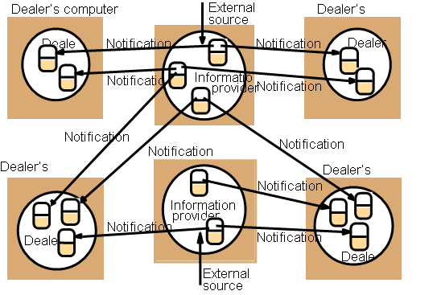
Dealing Room System

Slide 67
Event Types:
An event source can generate events of one or more different types.
Each event has attributes that specify information about events , such as name or identifier of the object that generated it , its operation, its parameters and the time.
Types and attributes are used both in subscribing to events and in notification.
Whenever an event of that type occurs that matches the attributes , the interested parties will be notified.

Slide 68
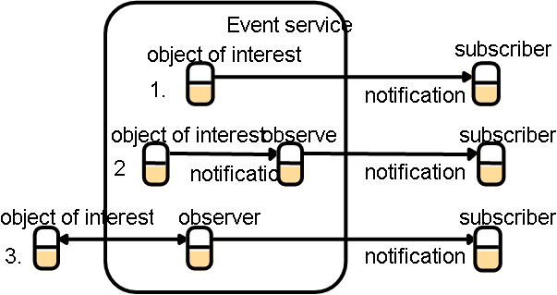
The Participants in Distributed Event Notification:
Architecture for distributed event notification:

Slide 69
It specifies the role played by the objects that participated in event based systems.
This is designed to decouple the publishers from the subscribers, allowing publishers to be developed independently of their subscribers.
The main component is event service that maintains a database of published events and subscribers interest.
Subscribers inform the event service about the type of events they are interested in.
When an event occurs at an object of interest a notification is sent to the subscribers to that type of event.

Slide 70
Role of participating objects:
The object of interest: This is an object that experience change of state. Its change of state , might be the interest of other objects.
Event: An event occurs at an object of interest as the result of the completion of a method execution .
Notification: It is an object that contains information about an event. It contains the type of event and its attributes. The attributes which includes the identity of the object of interest, the method invoked, and the time of occurrence or a sequence number

Slide 71
Subscriber: It is an object that has subscribed to some type of events in another object.It receives notification of such events.
Observer objects: The main purpose of an observer is to decouple an object of interest from its subscribers.
Publisher: This is an object that declare that it will generate notification of particular type of event. A publisher may be an object of interest or an observer.

Slide 72
In the above figure:Architecture for distributed event notification:
An object of interest inside the event service without an observer. It sends notification directly to the subscriber.
An object of interest inside the event service with an observer. The object of interest sends notification via the observer to the subscribers.
The object of interest outside the event service. In this observer queries the object of interest in order to discover when event occurs. The observer sends notification to the subscribers.

Slide 73
Role of Observers:
Forwarding
Filtering of Notifications
Patterns of Events
Notification Mailboxes

Slide 74
Forwarding: This observer carry out all the work of sending notifications to subscribers on behalf of one or more objects of interest.
Filtering of Notification: Filters may be applied by an observer so as to reduce the number of notification received according to some predicate on the content of each notification.(withdrawal from bank account – when only > $100)

Slide 75
Patterns of events: This specifies the relationship b/w several events. Subscriber may be interested in receiving events only when 3 withdrawals from bank account without intervening deposits.
Notification Mailbox: Notification needs to be delayed until potential subscriber is ready to receive them. In this case observer take on a role of notification mailbox , which is to receive notification on behalf of subscriber and only passing them on when subscriber is ready.

Slide 76
5.17 Explain how a forwarding observer may be used to enhance the reliability and performance of objects of interest in an event service.
Reliability:
The forwarding observer can retry notifications that fail at intervals of time.
If the forwarding observer is on the same computer as the object of interest, then the two could not fail independently.
Performance:
The forwarding observer can optimize multicast protocols to subscribers.

Slide 77
3.Define the integrity property of reliable communication and list all the possible threats to integrity from users and from system components. What measures can be taken to ensure the integrity property in the face of each of these sources of threats.
Integrity - the message received is identical to the one sent and no messages are delivered twice.
Threats from users:
Injecting spurious messages, replaying old messages, altering messages during transmission
Threats from system components:
messages may get corrupted .
messages may be duplicated by communication protocols that retransmit messages.

Slide 78
For threats from users - use secure channels and some authentication techniques
For threats from system components - Checksums to detect corrupted messages - but then we get a validity problem (dropped message). Duplicated messages can be detected if sequence numbers are attached to messages.

Slide 79
4.Outline the design of a scheme that uses message retransmissions with IP multicast to overcome the problem of dropped messages. Your scheme should take the following points into account:
i) there may be multiple senders;
ii) generally only a small proportion of
messages are dropped;
iii) unlike the request-reply protocol, recipients may not necessarily send a message within any particular time limit.
Assume that messages that are not dropped arrive in sender ordering.

Slide 80
To allow for point (i) senders must attach a sequence number to each message. Recipients record last sequence number from each sender and check sequence numbers on each message received.
For point (ii) a negative acknowledgement scheme is preferred (recipient requests missing messages, rather than acknowledging all messages). When they notice a missing message, they send a message to the sender to ask for it. To make this work, the sender must store all recently sent messages for retransmission. The sender re-transmits the messages as a unicast datagram.

Slide 81
Point (iii) - refers to the fact that we can’t rely on a reply as an acknowledgement. Without
acknowledgements, the sender will be left holding all sent messages in its store indefinitely. Possible solutions:
a) senders discards stored messages after a time
limit
b) occasional acknowledgements from recipients which may be piggy backed on messages that are sent. Note requests for missing messages and acknowledgments are simple - they just contain the sequence numbers of a range of lost messages.

Slide 82
Consider a simple server that carries out client requests without accessing other servers. Explain why it is generally not possible to set a limit on the time taken by such a server to respond to a client request. What would need to be done to make the server able to execute requests within a bounded time? Is this a practical option?
Ans:
The rate of arrival of client requests is unpredictable.
If the server uses threads to execute the requests concurrently, it may not be able to allocate sufficient time to a particular request within any given time limit.
If the server queues the request and carries them out one at a time, they may wait in the queue for an unlimited amount of time.
To execute requests within bounded time, limit the number of clients to suit its capacity. To deal with more clients, use a server with more processors. After that, (or instead) replicate the service....
The solution may be costly and in some cases keeping the replicas consistent may take up useful processing cycles, reducing those available for executing requests.

Slide 83
Define the integrity property of reliable communication and list all the possible threats to integrity from users and from system components. What measures can be taken to ensure the integrity property in the face of each of these sources of threats
Ans.
Integrity - the message received is identical to the one sent and no messages are delivered twice.
threats from users:
• injecting spurious messages, replaying old messages, altering messages during transmission
threats from system components:
• messages may get corrupted en route
• messages may be duplicated by communication protocols that retransmit messages.
For threats from system components. Checksums to detect corrupted messages - but then we get a validity problem (dropped message). Duplicated messages can be detected if sequence numbers are attached to messages.

Slide 84
Describe possible occurrences of each of the main types of security threat (threats to processes, threats to communication channels, denial of service) that might occur in the Internet.
Ans:
Threats to processes: without authentication of principals and servers, many threats exist. An enemy could
access other user’s files or mailboxes, or set up ‘spoof’ servers. E.g. a server could be set up to ‘spoof’ a bank’s
service and receive details of user’s financial transactions.
Threats to communication channels: IP spoofing - sending requests to servers with a false source address, man-in-
the-middle attacks.
Denial of service: flooding a publicly-available service with irrelevant messages.

